Slide 1
Computational Thinking & Systems Design Lecture 15 Revist ideas we learned: What we have learned from building a computing system?
Ben Koo
December 22, 2020

Slide 2
A curriculum based on Data-assimilation Orientation

Slide 3
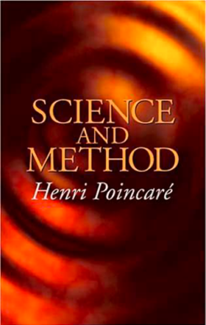

Data Science = Namespace Management
A natural equivalence that is
up-to-isomorphism to relevant domains.
A method that matches your application context,
without the losing scope of possible alternatives.

Slide 4
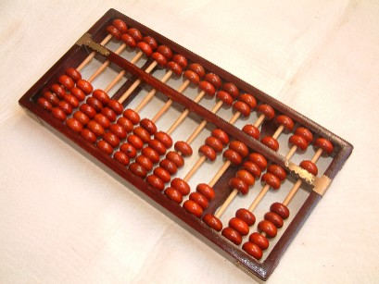
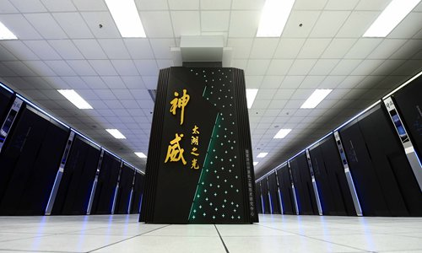
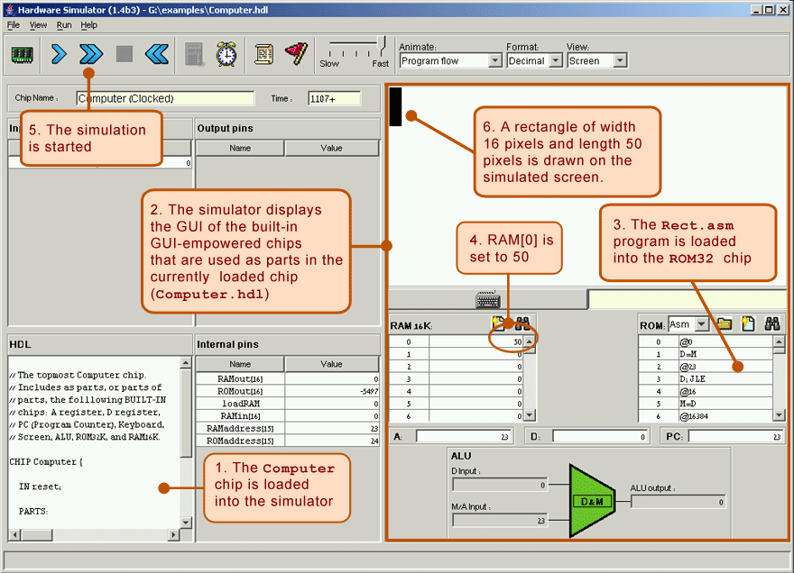
Proposed Computational Thinking
A Namespace of Functions for the available Computing Devices
that fit their respective application contexts.

Slide 5
Universal (Logical) Components
There are total of 16 possible 2 input 1 output Logical Functions.
Other than XOR, XNOR, A, B, ~A, ~B, 0, and 1, all remaining ones are
Universal Logical Gates…
A | B | Not(A and B) | Not(A or B) | A and Not(B) | B and Not(A) | A or Not(B) | Not(A) or B
0 | 0 | 1 | 1 | 0 | 0 | 1 | 1
0 | 1 | 1 | 0 | 0 | 1 | 0 | 1
1 | 0 | 1 | 0 | 1 | 0 | 1 | 0
1 | 1 | 0 | 0 | 0 | 0 | 1 | 1

Slide 6
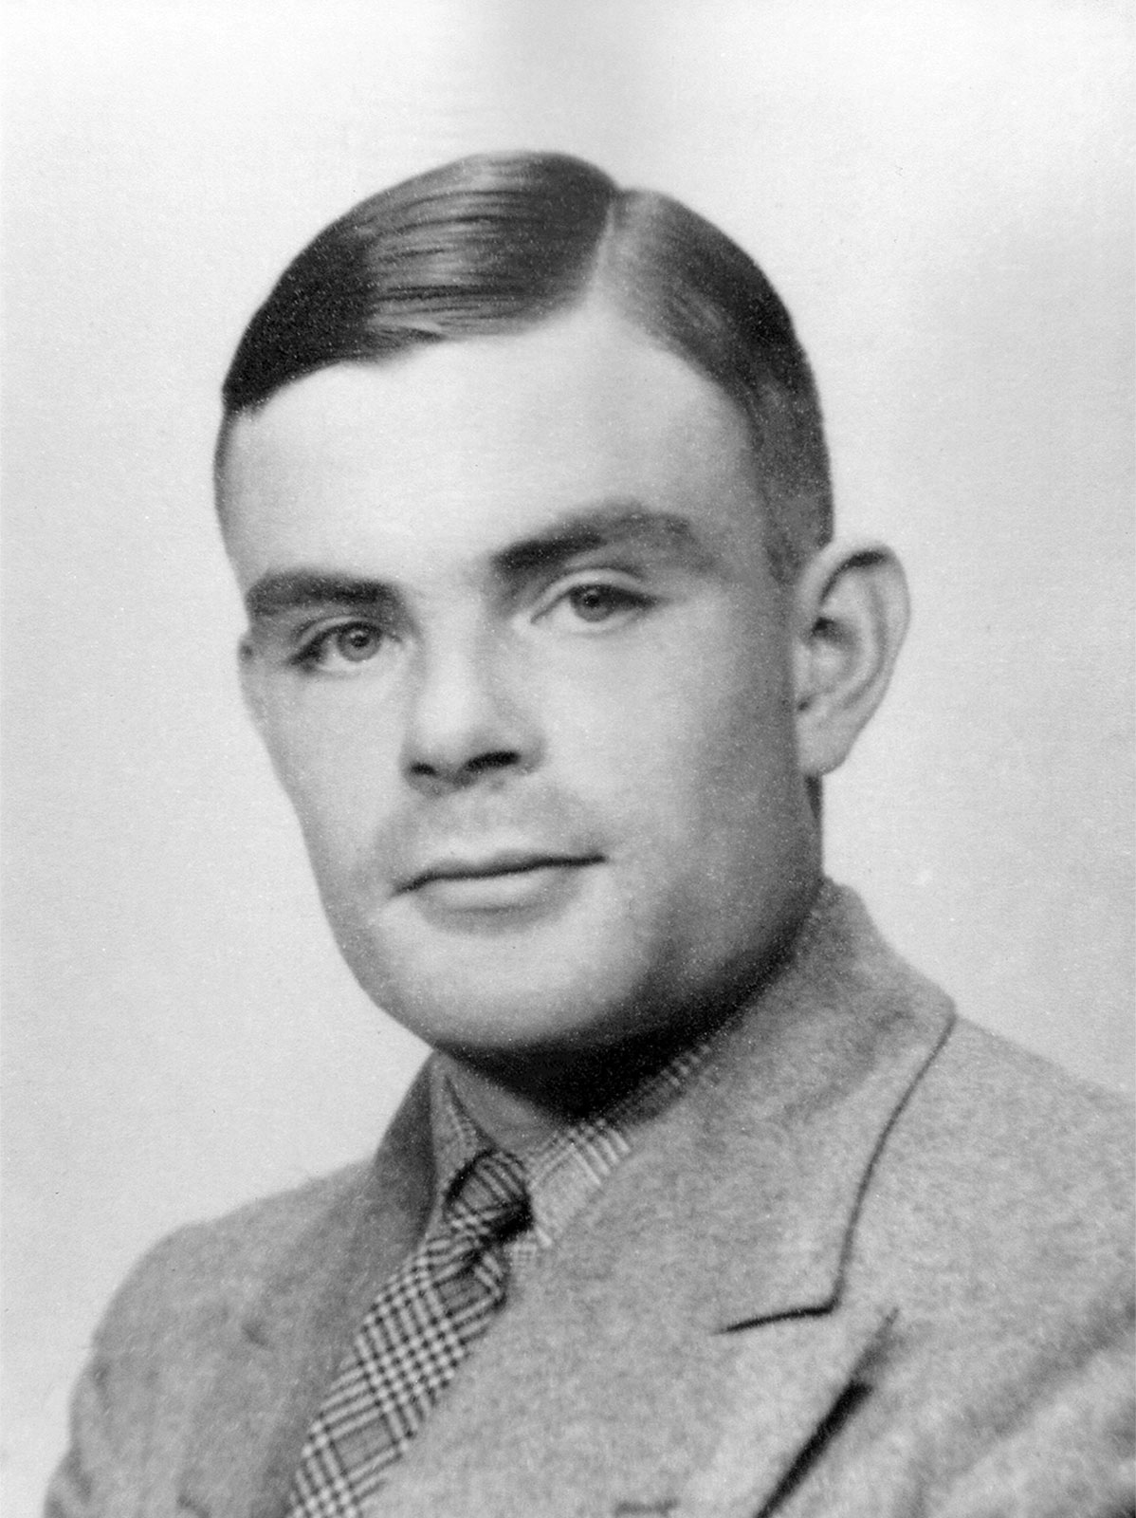
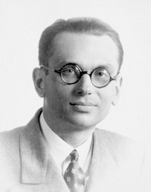
Universality and Turing Completeness
Turing complete means a machine can carry out all possible computations.
An operationalized
Model of
Universal Computation
Incompleteness
Theorem
Image source: Britannica.com Alan Turing
Image source: Wikipedia Kurt Godel

Slide 7
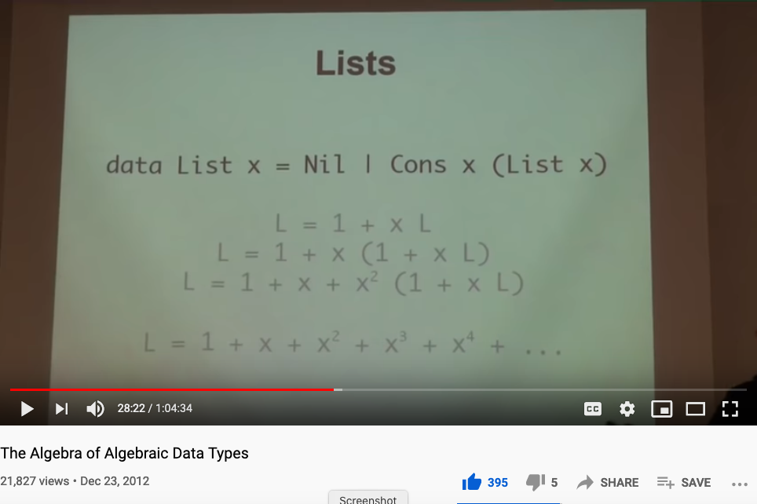
Did you watch the video on Types?
Huawei VP Mr. Yang Shaoqing
The Algebra of Algebraic Data Types

Slide 8
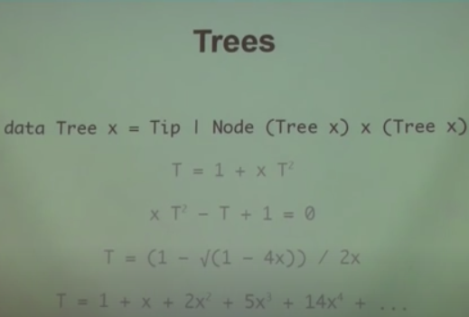
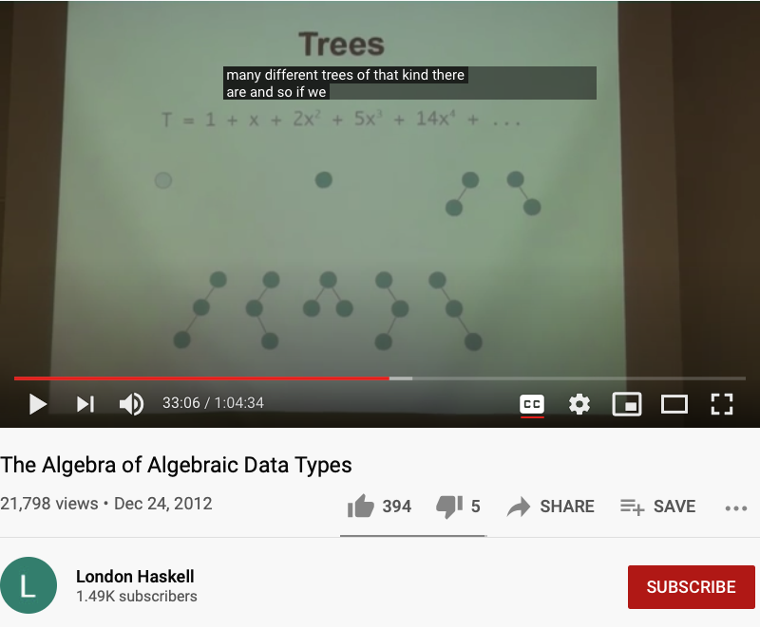
The Algebraic features of Data Types
Huawei VP Mr. Yang Shaoqing
https://youtu.be/YScIPA8RbVE?t=2040
https://youtu.be/YScIPA8RbVE?t=1986

Slide 9
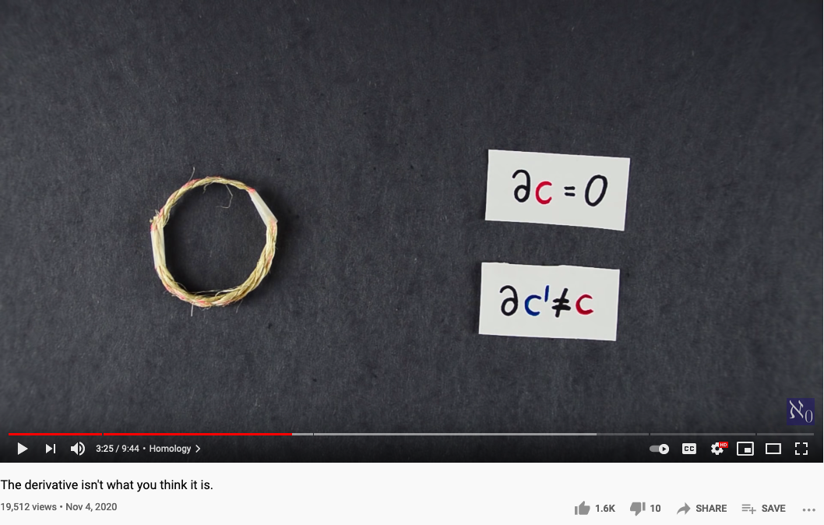
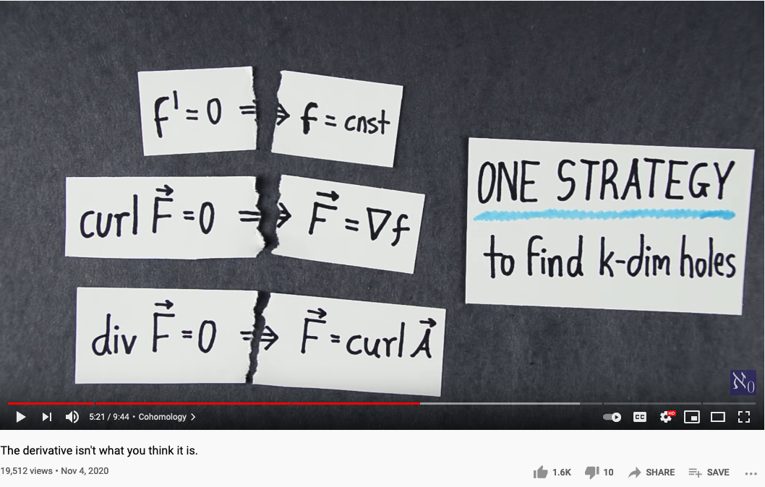
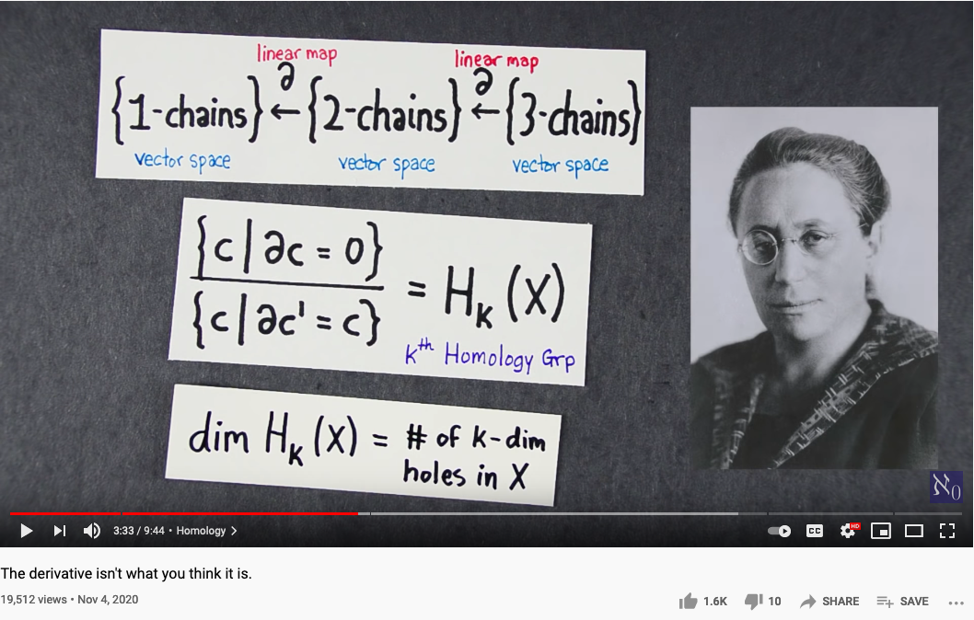
One Ring that rules them all (One Strategy to find all holes)
Source of Video : The Derivative isn’t what you think it is, by Aleph 0

Slide 10
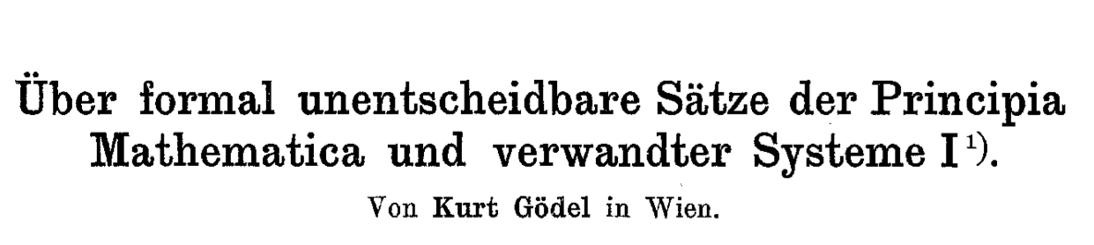
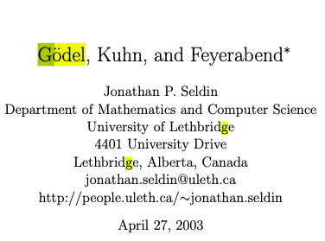
Automation can be applied to NsM
In mathematical logic, a Gödel numbering is a function that assigns to each symbol and well-formed formula of some formal language a unique natural number, called its Gödel number. The concept was used by Kurt Gödel for the proof of his incompleteness theorems. (Gödel 1931)
- Wikipedia on Gödel numbering
A question of Science and Commensurability
Paradigm shifting concepts
and
incommensurable terms
Thomas Kuhn [4] has presented a view of the history of science as a succession of “paradigms” which are not completely comparable with each other. Karl Popper [8] has attacked this view as being relativistic and denying that there is objective scientific truth. Popper seems to be saying that in order for science to be objectively true, every two scientific theories must be completely comparable. In taking this position, Popper is making a claim for a kind of completeness that is ruled out for theories strong enough to be “interesting” by Godel’s Incompleteness Theorem. In this paper, Godel’s Incomplete- ness Theorem and its proof will be used to draw conclusions about this conflict between Kuhn and Popper. In particular, it will be argued that if Popper had taken Godel’s Incompleteness Theorem into account, he would have wound up with a position consistent with that of Kuhn. Godel’s Incompleteness Theorem will also be used to argue that Feyerabend [3] does not really have an argument that there is no objective scientific method. The paper will close with some remarks on what might really count as objective scientific truth.
Normal Science
Model
Drift
Model Crisis
Model Revolution
Paradigm
Change

Slide 11
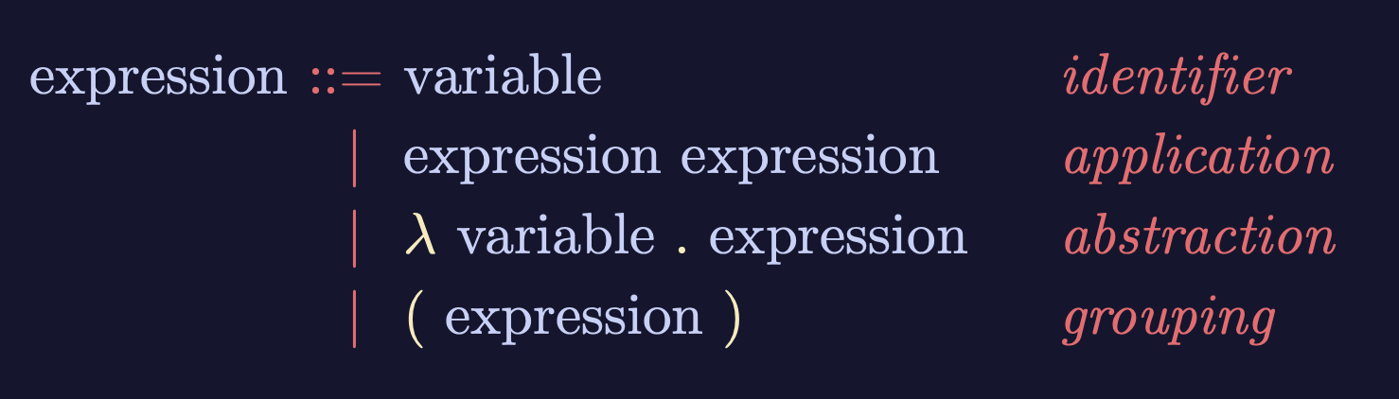
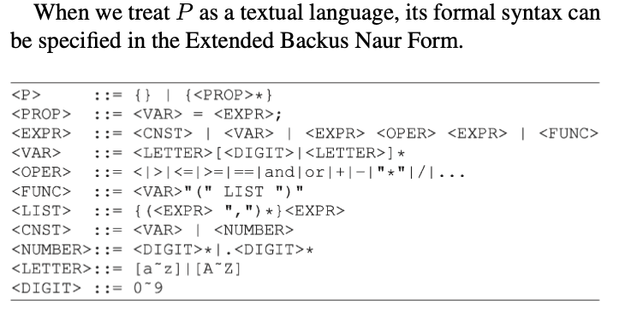

Lambda-Calculus is an Ouroboros
Variable
Expression1
Expression2
𝜆
Variable
Expression
( )
Expression
Lambda calculus as an executable rewrite process is a Lattice/Poset.
Paradigm shifting concepts
and
incommensurable terms
Normal Science
Model
Drift
Model Crisis
Model Revolution
Paradigm
Change
Learning as a vocabulary acquisition process!
Backus-Naur Form provides a way to customize the “concrete syntax” of formal languages.

Slide 12
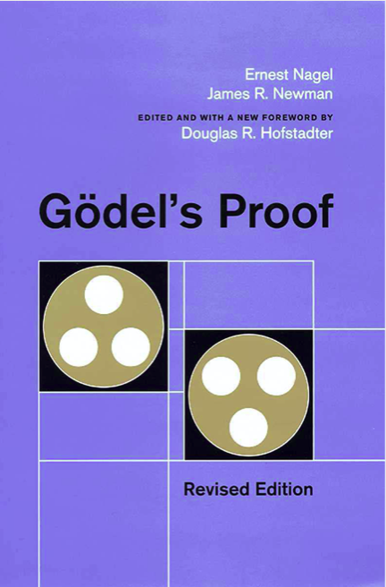
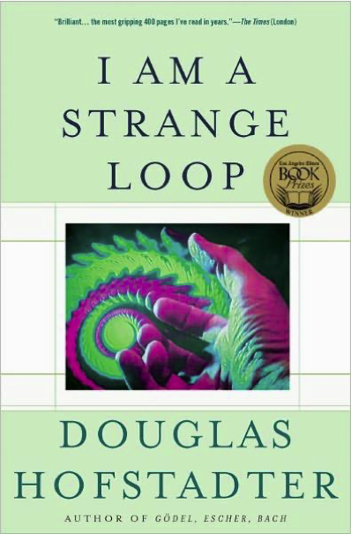
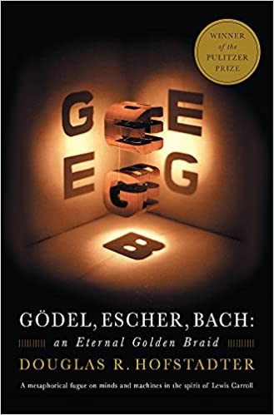
Iteration and Recursion

Slide 13
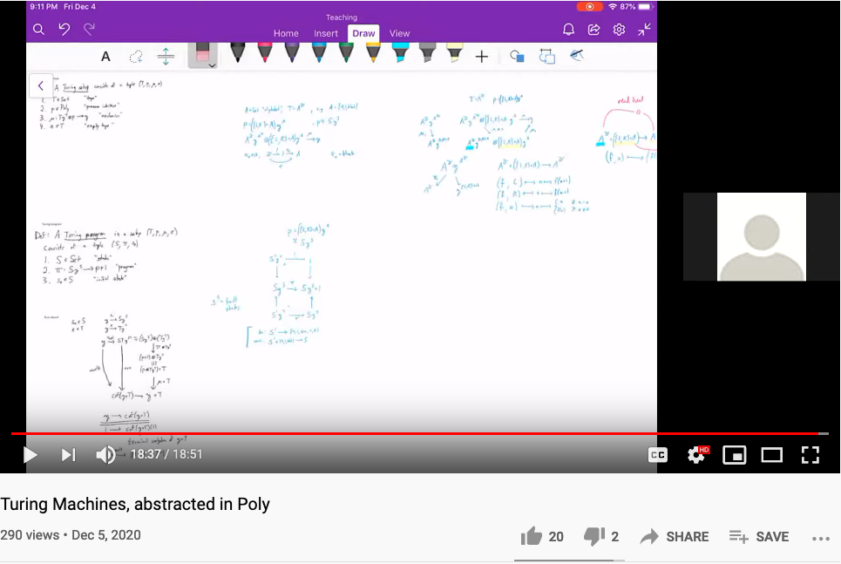
Turing Machine in terms of Poly (Category Theoretical Terms)
Huawei VP Mr. Yang Shaoqing
Dr. David Spivak on Youtube Topos Channel

Slide 14
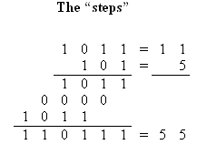
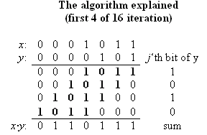
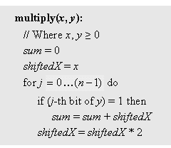

Example I: multiplication
Run-time: proportional to n
Can be implemented in SW or HW
Division: similar idea.

Slide 15
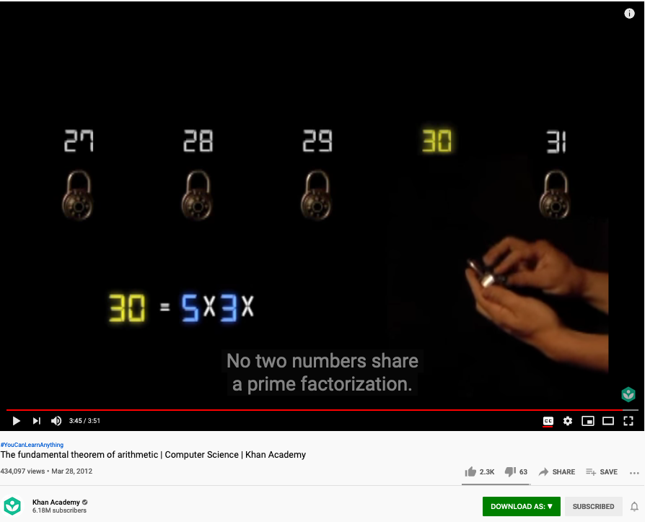
The Fundamental Theorem of Arithmetic (Name Space Management Trick)
Huawei VP Mr. Yang Shaoqing
The fundamental theorem of arithmetic states that every positive integer (except the number 1) can be represented in exactly one way apart from rearrangement as a product of one or more primes (Hardy and Wright 1979, pp. 2-3).
- Excerpt for MathWorld website
https://youtu.be/8CluknrLeys?t=225
The fundamental theorem of arithmetic | Computer Science | Khan Academy

Slide 16
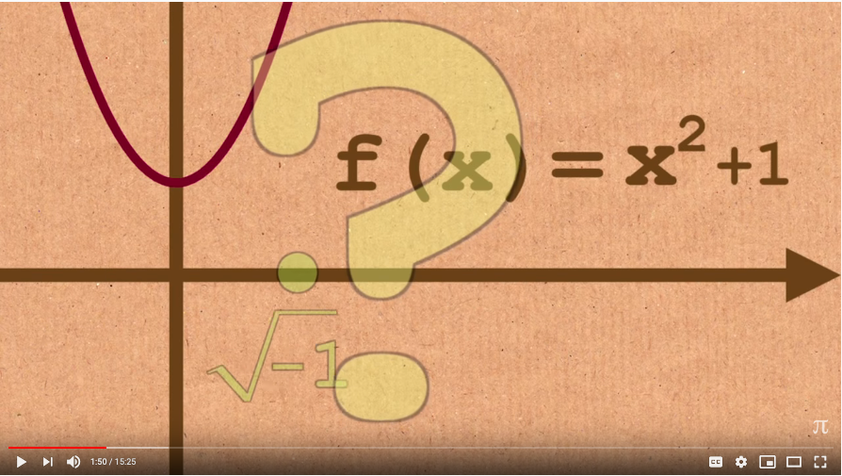
The Fundamental Theorem of Algebra
Huawei VP Mr. Yang Shaoqing
The fundamental theorem of algebra states that every non-constant single-variable polynomial with complex coefficients has at least one complex root. This includes polynomials with real coefficients, since every real number is a complex number with its imaginary part equal to zero.
https://youtu.be/shEk8sz1oOw?t=110
- Excerpt for Wikipedia
Fundamental Theorem of Algebra - Numberphile

Slide 17
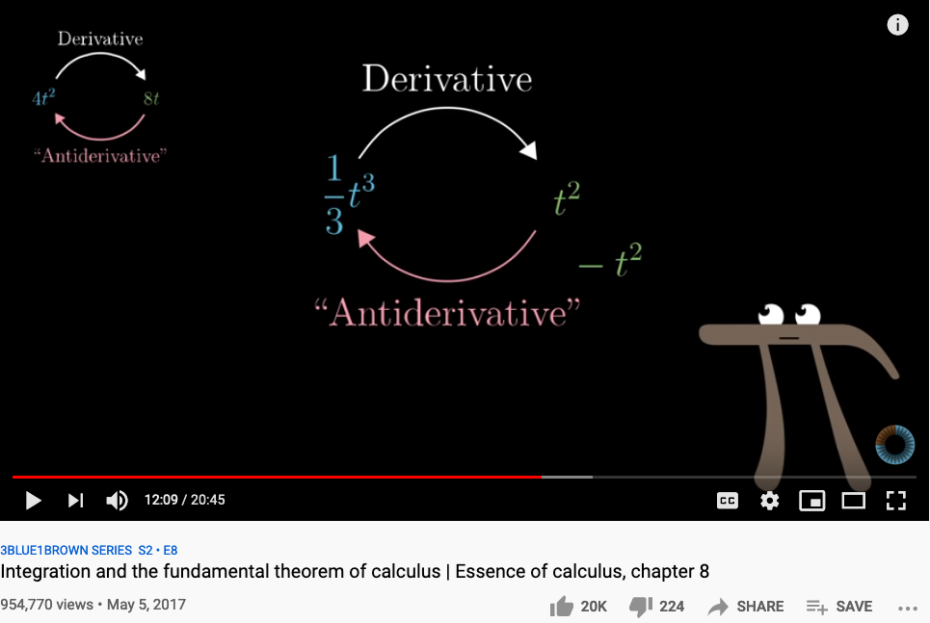
The Fundamental Theorem of Calculus
The fundamental theorem of calculus is a theorem that links the concept of differentiating a function with the concept of integrating a function.
The first part of the theorem, sometimes called the first fundamental theorem of calculus, states that one of the antiderivatives (also called indefinite integral), say F, of some function f may be obtained as the integral of f with a variable bound of integration. This implies the existence of antiderivatives for continuous functions.^{[1]}
Conversely, the second part of the theorem, sometimes called the second fundamental theorem of calculus, states that the integral of a function f over some interval can be computed by using any one, say F, of its infinitely many antiderivatives. This part of the theorem has key practical applications, because explicitly finding the antiderivative of a function by symbolic integration avoids numerical integration to compute integrals. This provides generally a better numerical accuracy.
Huawei VP Mr. Yang Shaoqing
- Excerpt for Wikipedia
https://youtu.be/rfG8ce4nNh0?t=729
3BLUE1BROWN SERIES S2 • E8

Slide 18
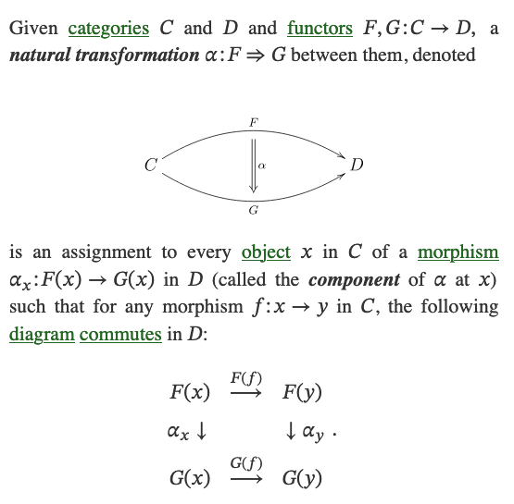
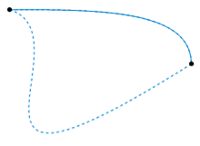
What is a Natural Transformation?
The two dashed paths shown above are homotopic relative to their endpoints. The animation represents one possible homotopy.
Image and Text Source: https://ncatlab.org/nlab/show/natural+transformation

Slide 19
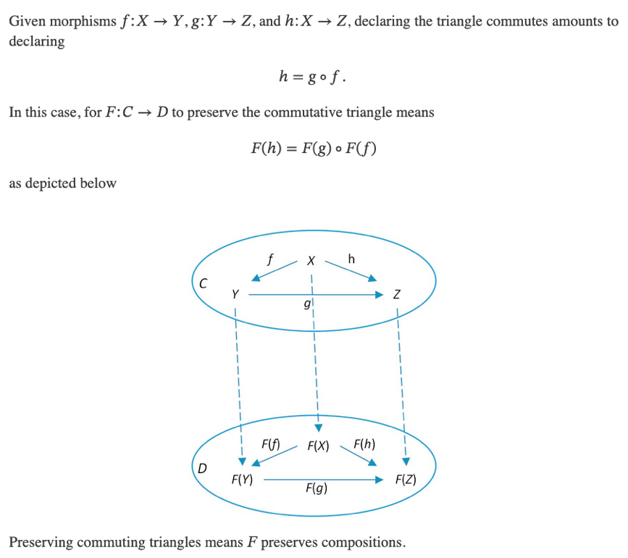
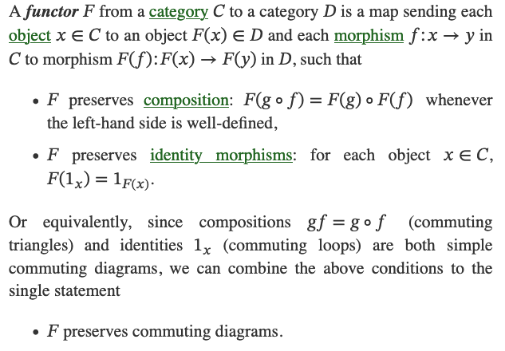
What is a Functor?
Image and Text Source: https://ncatlab.org/nlab/show/functor

Slide 20
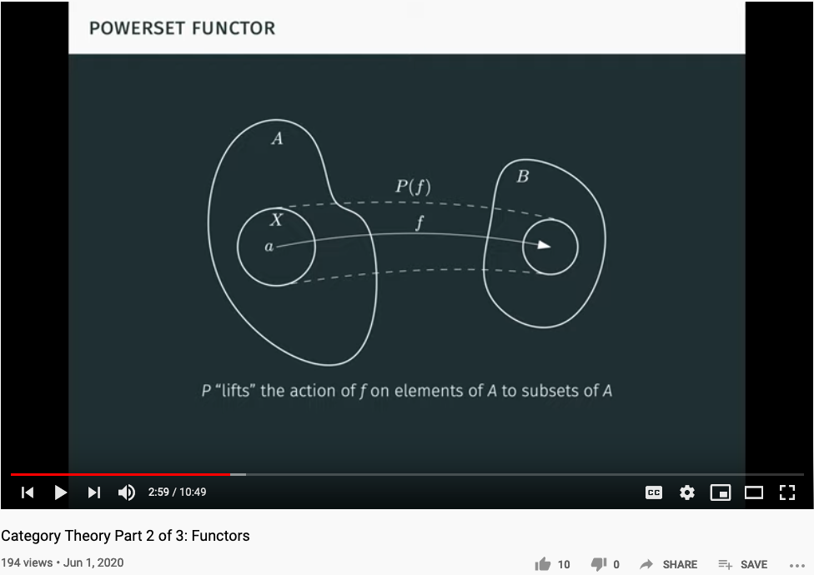
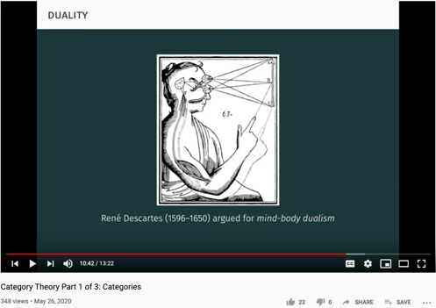
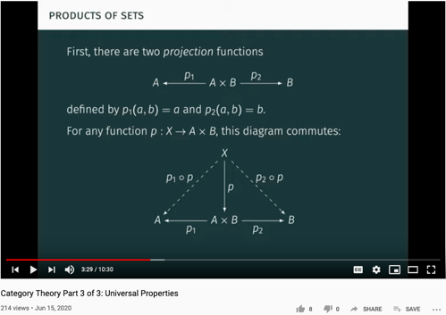
Functor as Structure Preserving Arrow
Youtuber blargoner: An introduction to categories, functors, and universal properties, with applications to the lambda calculus and functional programming.

Slide 21
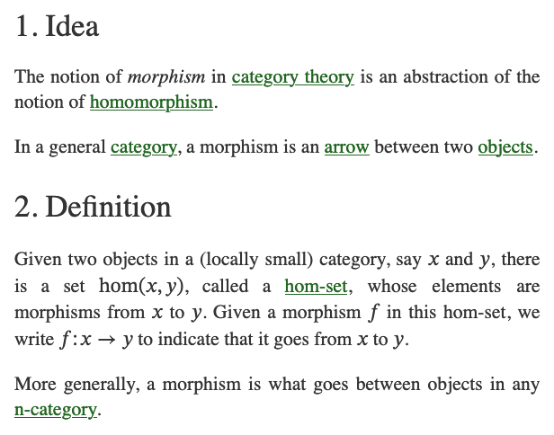
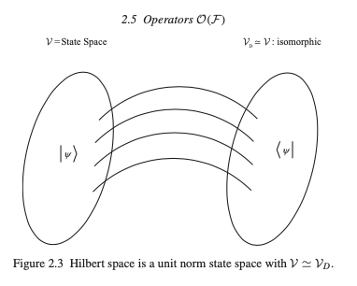
What is a Morphism (Function)?
Image and Text Source: https://ncatlab.org/nlab/show/morphism
Image Source: P.15 of Path Integral and Hamiltonian by Belal Baaquie

Slide 22
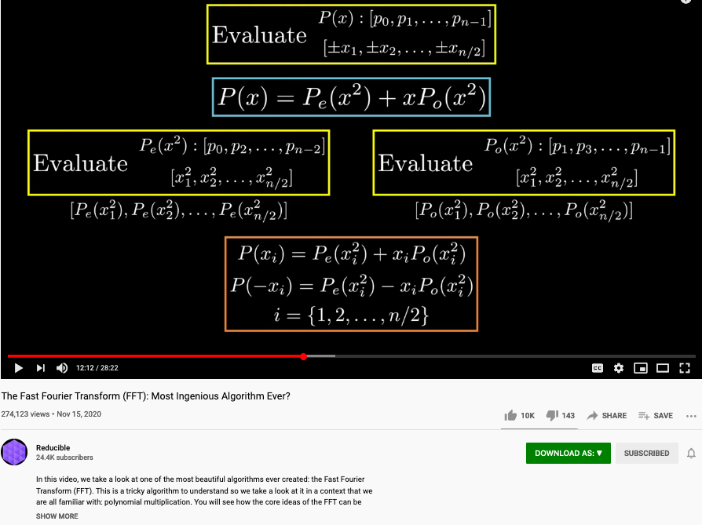
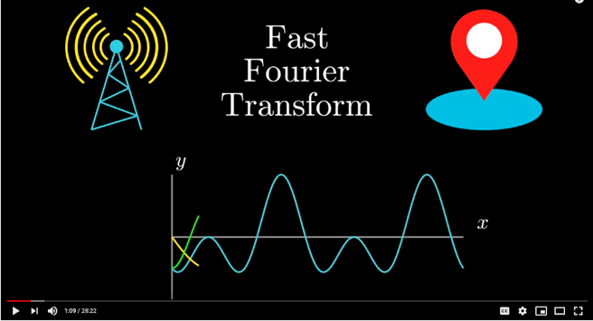
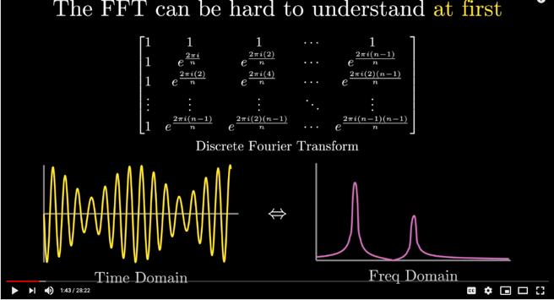
The Polynomial trick also appears in Fast Fourier Transform
Huawei VP Mr. Yang Shaoqing
https://youtu.be/h7apO7q16V0?t=732

Slide 23
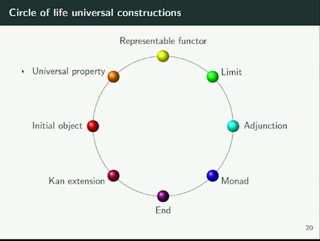
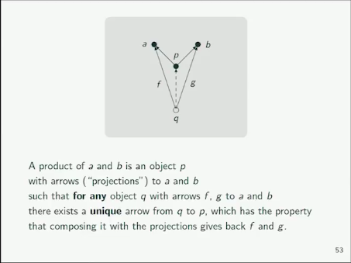
When explaining the idea of Universal Properties …
We have explained certain aspects of all other properties in the ring.
Huawei VP Mr. Yang Shaoqing

Slide 24
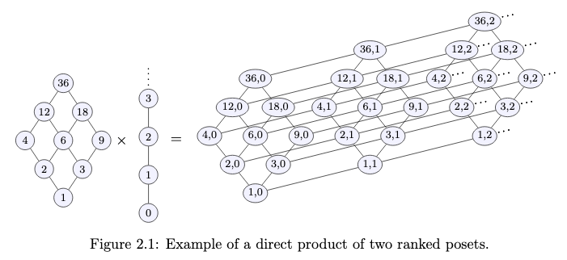
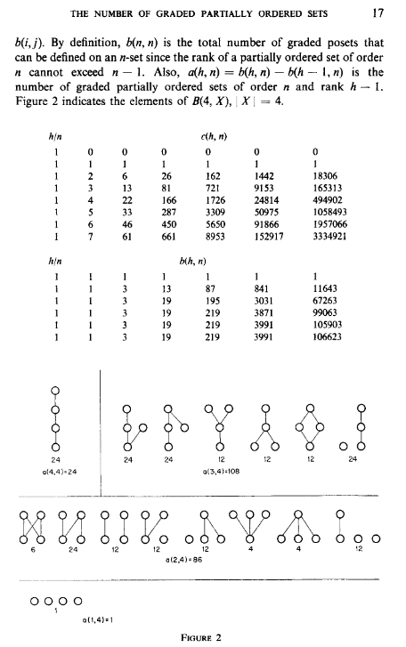
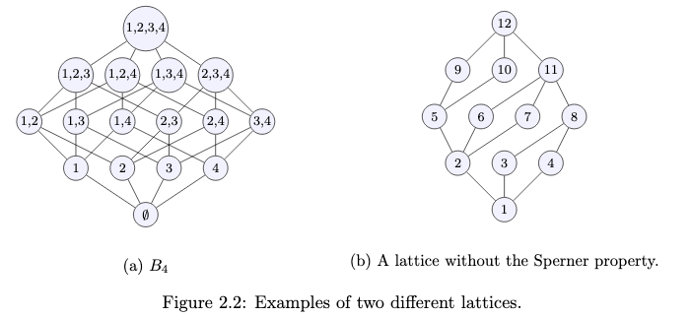
Posets as Composable Namespaces
Image Source: Symmetric chain decompositions of partially ordered sets by Ondrej Zjevik
Image Source: The Number of Ordered Partially Ordered Sets by David Klarner

Slide 25
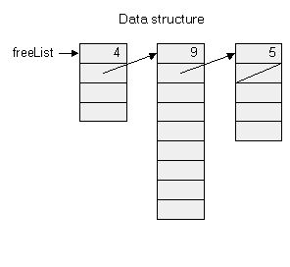
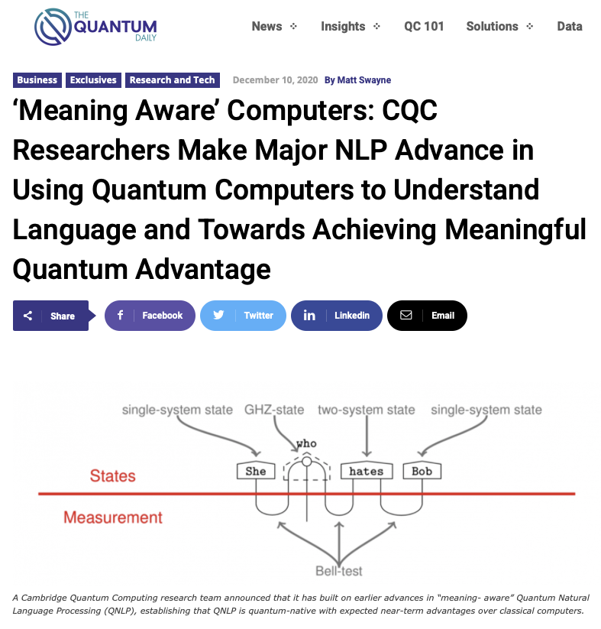
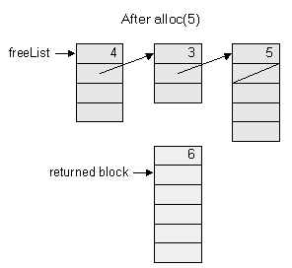
All computable content can be organized into a single Tapestry
Memory management in Jack Operating System

Slide 26
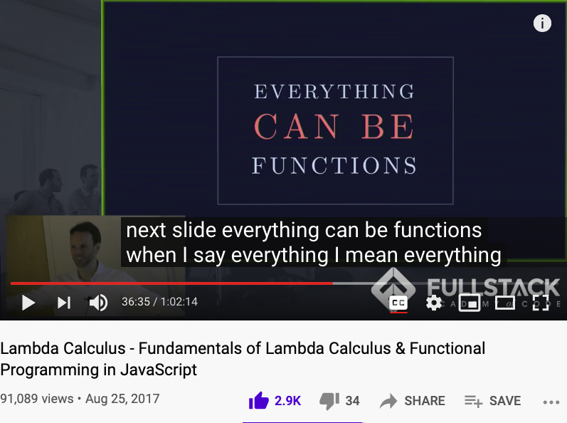
Universality is in your pocket (cellphone)
A lecture that students of Cognitive Foundation must watch several times…

Slide 27
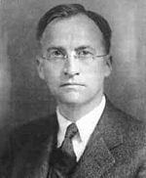
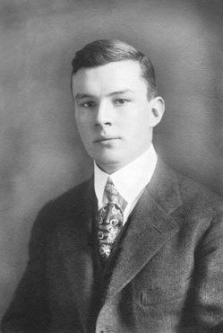
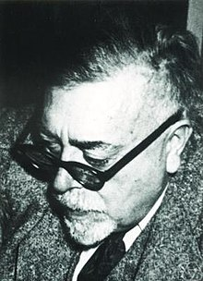

The Members of a Bird Watching Club
advisor
to
Members of
the same bird watching club
George D. Birkhoff
father of
Haskell Brooks Curry
Norbert Wiener
During this period, Curry had become interested in logic. Originally, all of his logic was reading on the side, and at one point he was supposed to be working on a dissertation on a topic in differential equations assigned to him by George D. Birkhoff. Furthermore, he was getting advice from various faculty members at Harvard and elsewhere to stay away from logic. This advice was especially strong from Norbert Wiener, who was at MIT and who was a member of the same birdwatching club as Curry. But Curry had become too interested in logic to stop thinking about it.
- excepts from Internet Encyclopedia of Philosophy
Garrett Birkhoff
(Lattice Theory)

Slide 28
Types in Name Space Management
Every KIND of Lambda Expression is a Type,
and
a small number of Types can be Computationally Complete…
a
Variable
b
Expression1
Expression2
c
𝜆
Variable
Expression
( )
d
Expression
e (empty type)

Slide 29





Bird Watcher and Combinatorics
I, K, B, C(W), S
Idiot
Blue Bird
Kestrel
Cardinal
Startling
The website of absint.com stated: “Safety standards like ISO 26262, DO-178B, DO-178C, IEC-61508, and EN-50128 require identifying functional and non-functional hazards and demonstrating that the soft­ware does not violate the rele­vant safety goals.”

Slide 30

Be Persistent…
Tries to convince each other
Haskell Brooks Curry
Norbert Wiener
Curry had the idea for using operators which he called combinators, the term we still use today. He used these operators to analyze this rule of substitution, and he concluded that this idea might lead to a dissertation. When he took this idea to several professors, he got a different reaction than he had previously had about staying away from logic. This was especially true of Norbert Wiener at MIT, who said that his opinion had been that logic was a subject to be avoided “unless you had something to say,” and since Curry clearly had something to say, “strength to your right arm!”
- excepts from Internet Encyclopedia of Philosophy

Slide 31

An Inherited Idea: Function Currying
Acknowledged the source from
Haskell Brooks Curry
Moses Schönfinkel
The method of using only functions of one argument has come to be called currying, … Curry himself learned of this use of his name in his last years, and he protested because he had gotten the idea from Schönfinkel, but this use of Curry’s name has stuck.
- excepts from Internet Encyclopedia of Philosophy

Slide 32

The Five Combinators
I, K, B, W, S
I
K
B
W
S
- excepts from Internet Encyclopedia of Philosophy

Slide 33










The Leaders of the Five Tribes
Image Source: P. 240 of The Master Algorithm
33

Slide 34




A few screen shot for basic data types?
Variable
Expression1
Expression2
𝜆
Variable
Expression
( )
Expression

Slide 35
An issue in Name Space Management
Over his career, Curry changed several times the words he used to denote the formal objects of a formal system. In his earliest work on combinatory logic, he called them “entities” (using the German word Etwas as a noun in his dissertation, which was written in German). However, in a discussion with a philosopher (whom he did not name in his later years), he was told that his use of that word implied some philosophical conclusions with which he disagreed. At that point, he decided to use the word “term” instead. It is now common to refer to “combinatory terms” and “𝝺-terms”. However, this caused him a problem when he was dealing with a formal system of logic with quantifiers, since the terms would be what are usually called “formulas”, and there are other formal objects called “terms”. So in the end, he coined his own word by taking the first syllable of the word “object”, and started calling them obs. To some people, the word ob appeared to refer specifically to combinatory logic, but in fact Curry used the word for formal objects of any kind of formal system.
- excepts from Internet Encyclopedia of Philosophy

Slide 36


Color code and rearrange the “Balanced Index”
Energy
(Initial Object)
Financial
Food
Air
Health
Water
Internal Social
External Social
Bio Diversity
(Terminal Object)
Learning and Growth

Slide 37

Color code and rearrange the “Balanced Index”
Professor Dave Explains: The Cell Cycle and its Regulation

Slide 38







All System can be approximated as Partially Ordered Set
Numbers are naturally related to Music:

Slide 39



All meaningful expressions can be modeled as $𝒫ω$
Prof. Dana Stewart Scott
Image Source: Britannica

Slide 40



Lattice represents a Universal Data Type
Patrick Cousot
Radhia Cousot
Source of Text : https://www.di.ens.fr/~cousot/publications.www/CousotCousot-POPL-77-ACM-p238--252-1977.pdf

Slide 41

Memory management (naive)
When a program constructs (destructs) an object, the OS has to allocate (de-allocate) a RAM block on the heap:
alloc(size): returns a reference to a free RAM block of size size
deAlloc(object): recycles the RAM block that object refers to
The data structure that this algorithm manages is a single pointer: free.

Slide 42

Memory management (improved)

Slide 43
All computable content can be organized into a single Tapestry
Memory management in Jack Operating System

Slide 44
Universality is in your pocket (cellphone)
A lecture that students of Cognitive Foundation must watch several times…

Slide 45
A curriculum based on Data-assimilation Orientation

Slide 46













An integrated (ethical) architecture
to implement the Master Algorithm
Software
Hardware
Scientific “Evolution”
Neutral Network
Symbolic Logic
Causal Probability
Conceptual Analogies
T. Kuhn
Content
IoT and Quantum Computing
TPU
GPU
CPU
Big Data
Computed Data
Artificial Data
Resource
Standard
J. Hinton
Distributed
Centralized
General Protocol
Curry Haskell
J. Pearl
Governance Strategies
Collective learning systems
Data Assets, Structures
Extreme Learning Process
G. Lakoff
Computing Architectures, Instrumentation
Encoding strategy, Ontology, Epistemology

Slide 47




Performance Measurements
Turing award winners, and authors of
Computer Architecture: a quantitative approach
Key Member of
RISC-V
Instruction Set
Former president of
Stanford U.
Image source: UC Berkeley David Patterson
Image source: Wikipedia John Hennesey

Slide 48
Conclusion/Summary
Computational Thinking is rooted in Logic (re-write/substitution system):
Namespace management (NsM) and function composition can be scaled up by computers
The hierarchy of namespaces (the six layers of languages) helps disseminate computational thinking in a Systematic Fashion (System Design)
Computational Thinking and Systems Design is domain independent:
Why: Universality can be expressed in compact and finite forms, so that it can be embedded in a portable device, mentally and physically.
How: Multi-layered System Design Languages enables engineering practice, inter-layer translation explains the design choices and performance tradeoffs
What: The vocabulary and syntax of each layer helps you focus your mind and efforts

Slide 49

Peek and poke
class Memory {
function int peek(int address)
function void poke(int address, int value)
function Array alloc(int size)
function void deAlloc(Array o)
}
Implementation: based on our ability to exploit exotic casting in Jack:

Slide 50
Graphics primitives (in the Jack OS)
class Math {
class String {
class Array {
class Output {
class Screen {
class Memory {
class Keyboard {
class Sys {
function (…)
…
}
Class Screen {
function void clearScreen()
function void setColor(boolean b)
function void drawPixel(int x, int y)
function void drawLine(int x1, int y1, int x2, int y2)
function void drawRectangle(int x1, int y1,int x2, int y2)
function void drawCircle(int x, int y, int r)
}

Slide 51

Memory-mapped screen

Slide 52

Pixel drawing
Implementation: using poke(address,value)

Slide 53



Image representation: bitmap versus vector graphics
pixel
(0,0)
bitmap
vector
Bitmap file: 00100, 01010,01010,10001,11111,10001,00000, . . .
Vector graphics file: drawLine(2,0,0,5), drawLine(2,0,4,5), drawLine(1,4,3,4)
Pros and cons of each method.
Notes:
53

Slide 54

Vector graphics: basic operations
0
1
2
3
.
.
.
drawPixel(x,y)
(Primitive operation)
0
1
drawLine(x1,y1,x2,y2)
2
3
Screen =
grid of pixels
drawCircle(x,y,r)
.
.
drawRectangle(x1,y1,x2,y2)
.
drawTriangle(x1,y1,x2,y2,x3,y3)
etc. (a few more similar operations)
0
1
2
3
4
5
6
7
8
9
10
11
12
13
0
1
drawLine(0,3,0,11)
drawRectangle(1,3,5,9)
drawLine(1,12,2,12)
drawLine(3,10,3,11)
drawLine(6,4,6,9)
drawLine(7,0,7,12)
drawLine(8,1,8,12)
2
3
4
5
6
7
8
9
Notes:
54

Slide 55

How to draw a line?
drawLine(x1,y1,x2,y2)
Basic idea: drawLine is implemented through a sequence of drawPixel operations
Challenge 1: which pixels should be drawn ?
Challenge 2: how to draw the line fast ?
Simplifying assumption: the line that we are asked to draw goes north-east.
Notes:
55

Slide 56

Line Drawing
Given: drawLine(x1,y1,x2,y2)
Notation: x=x1, y=y1, dx=x2-x1, dy=y2-y1
Using the new notation: We are asked to draw a line between (x,y) and (x+dx,y+dy)
dy
dx
set (a,b) = (0,0)
while there is more work to do
drawPixel(x+a,y+b)
decide if you want to go right, or up
if you decide to go right, set a=a+1; if you decide to go up, set b=b+1
set (a,b) = (0,0)
while (a ≤ dx) and (b ≤ dy)
drawPixel(x+a,y+b)
decide if you want to go right, or up
if you decide to go right, set a=a+1; if you decide to go up, set b=b+1
Notes:
56

Slide 57


Line Drawing algorithm
drawLine(x,y,x+dx,y+dy)
set (a,b) = (0,0)
while (a ≤ dx) and (b ≤ dy)
drawPixel(x+a,y+b)
decide if you want to go right, or up
if you decide to go right, set a=a+1; if you decide to go up, set b=b+1
drawLine(x,y,x+dx,y+dy)
set (a,b) = (0,0)
while (a ≤ dx) and (b ≤ dy)
drawPixel(x+a,y+b)
if b/a > dy/dx set a=a+1 else set b=b+1
Oy Vey
Notes:
57

Slide 58
Line Drawing algorithm, optimized
Motivation
When you draw polygons, e.g. in animation or video, you need to draw millions of lines
Therefore, drawLine must be ultra fast
Division is a very slow operation
Addition is ultra fast (hardware based)
drawLine(x,y,x+dx,y+dy)
set (a,b) = (0,0)
while (a ≤ dx) and (b ≤ dy)
drawPixel(x+a,y+b)
if b/a > dy/dx set a=a+1 else set b=b+1
b/a > dy/dx is the same as a*dy < b*dx
Define diff = a*dy – b*dx
Let’s take a close look at this diff:
b/a > dy/dx is the same as diff < 0
When we set (a,b)=(0,0), diff = 0
When we set a=a+1, diff goes up by dy
When we set b=b+1, diff goes down by dx
drawLine(x,y,x+dx,y+dy)
set (a,b) = (0,0), diff = 0
while (a ≤ dx) and (b ≤ dy)
drawPixel(x+a,y+b)
if diff < 0 set a=a+1, diff = diff + dx else set b=b+1, diff = diff - dy
Notes:
58

Slide 59


Circle drawing
The screen origin (0,0) is at the top left.

Slide 60


Some Final notes
CS is a science
What is science?
Reductionism
Life science: From Aristo (millions of rules) to Darwin (3 rules) to Watson and Crick (1 rule)
Computer science: We knew in advance that we could build a computer from almost nothing. In this course we actually did it.
Key lessons:
Elegance
Clarity
Simplicity
Playfulness.

